Slide 1



Seeing the Unseen – Research on online abuse affecting young people
First results
Hungary

Slide 2

Methodology
Premise: 1000 people, in-person research
Among 18-25 year olds
In the Visegrad Four countries (CZ, PL, SK, HU)
Trauma-sensitive approach
Special interviewer and shift supervisor training
Data collection period: Summer 2025

Slide 3
I. THE GRAVITY OF THE PROBLEM

Slide 4
Prevalence of online abuse

Slide 5
According to age and type of abuse

Slide 6
Screen time: Part of the problem or the root cause?

Slide 7
Other causes and consequences
Online competences, age, parental attitude, socioeconomic background...
Quality of life, social life, trust, self-image...

Slide 8
II. ASKING FOR HELP

Slide 9
Did you ask for help?

Slide 10
If you did, did you receive any?

Slide 11
If you did not ask for help, why?

Slide 12
The help expected

Slide 13
Trust in potential helpers

Slide 14
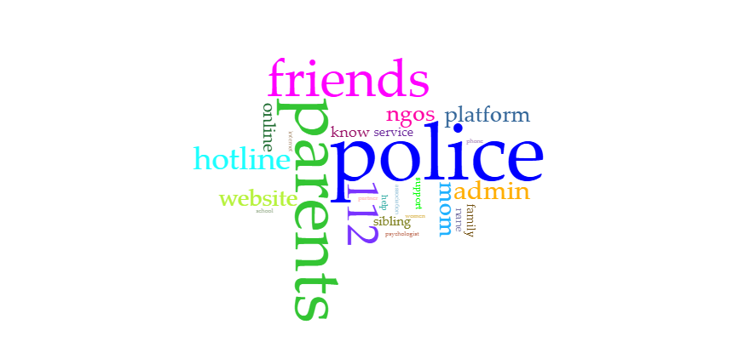
Who would you ask for help?

Slide 15
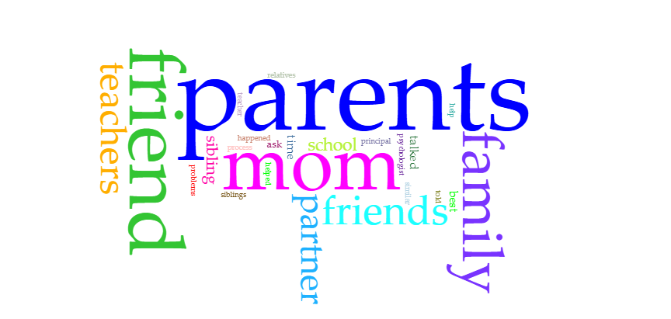
From victims: who helped in the end?

Slide 16
III. THE THRESHOLD

Slide 18
IV. CLOSING REMARKS

Slide 20
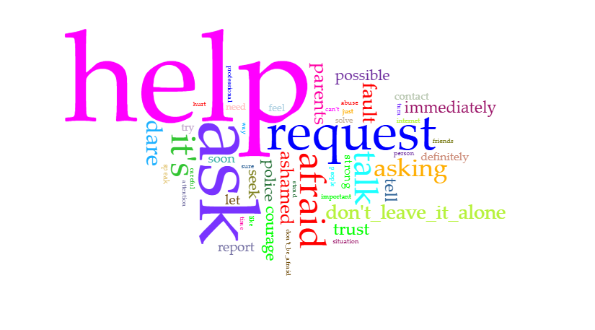
Would you say something else to the victims??

Slide 21
What’s next…
Examination of causes and consequences (correlations)
Identification of particularly vulnerable groups (cross-tabulation)
Comparison of Visegrad countries, examination of similarities and differences
Communication: Raising awareness, providing information, making suggestions

Slide 22
. . .

